Slide 1
Software & Azure
Notes:
Insert your text above

Slide 2
You'll learn
How do computers work?
How is software built?
What is Azure?
Cloud basics
What can you do with the cloud?
Cost management
Notes:
Insert your text above

Slide 3
Computer basics
Writing software
High-level instructions
  Turned into 0's and 1's
Using packages
Version control (git)
AI
Computer
Operating System
RAM storage
CPU
Disk storage
Devices
Monitor
Wi-Fi
…

Slide 4
Sharing software
Old way: let people build your code
  Fragile
New way: share a container

Slide 5
Software design basics
User device
Front-end
Server
User device
Front-end
API
Back-end
HTTPS protocol
…

Slide 6
Instagram case study
Meta Server
User device
B
API
ig
Back-end
A
C
ig
Front-end
D
User action (A) | Front-end API request (B) | Back-end action (C) | Back-end API response (D)
App opens
 | Fetch posts
 |  | Run recommendation algo
 |  |  | Post data
time

Slide 7
Instagram case study
Meta Server
User device
B
API
ig
Back-end
A
C
ig
Front-end
D
User action (A) | Front-end API request (B) | Back-end action (C) | Back-end API response (D)
Likes post
 | Register like
 |  | Store like in DB
 |  |  | OK
time

Slide 8
Azure & the cloud

Slide 9
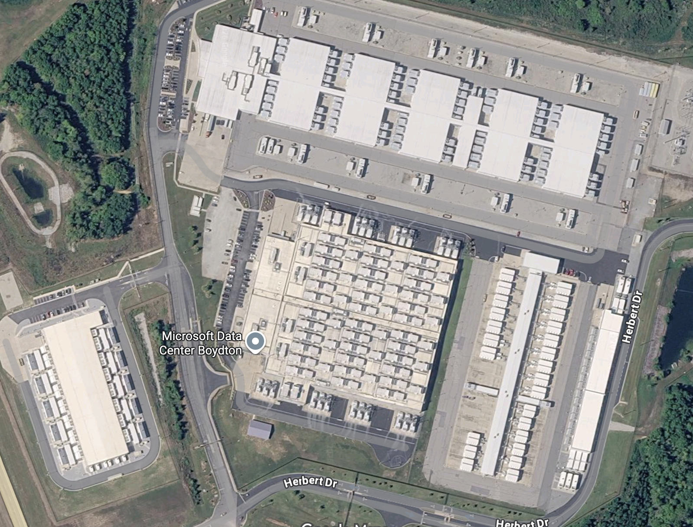

Slide 10

1.03 mile perimeter

Slide 11
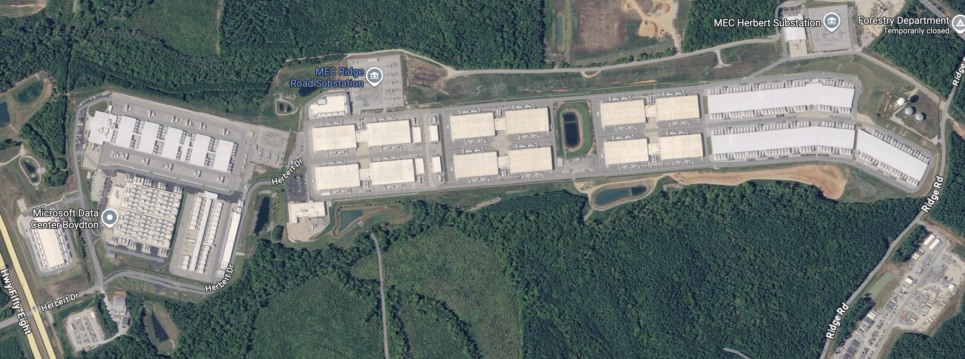

Slide 12
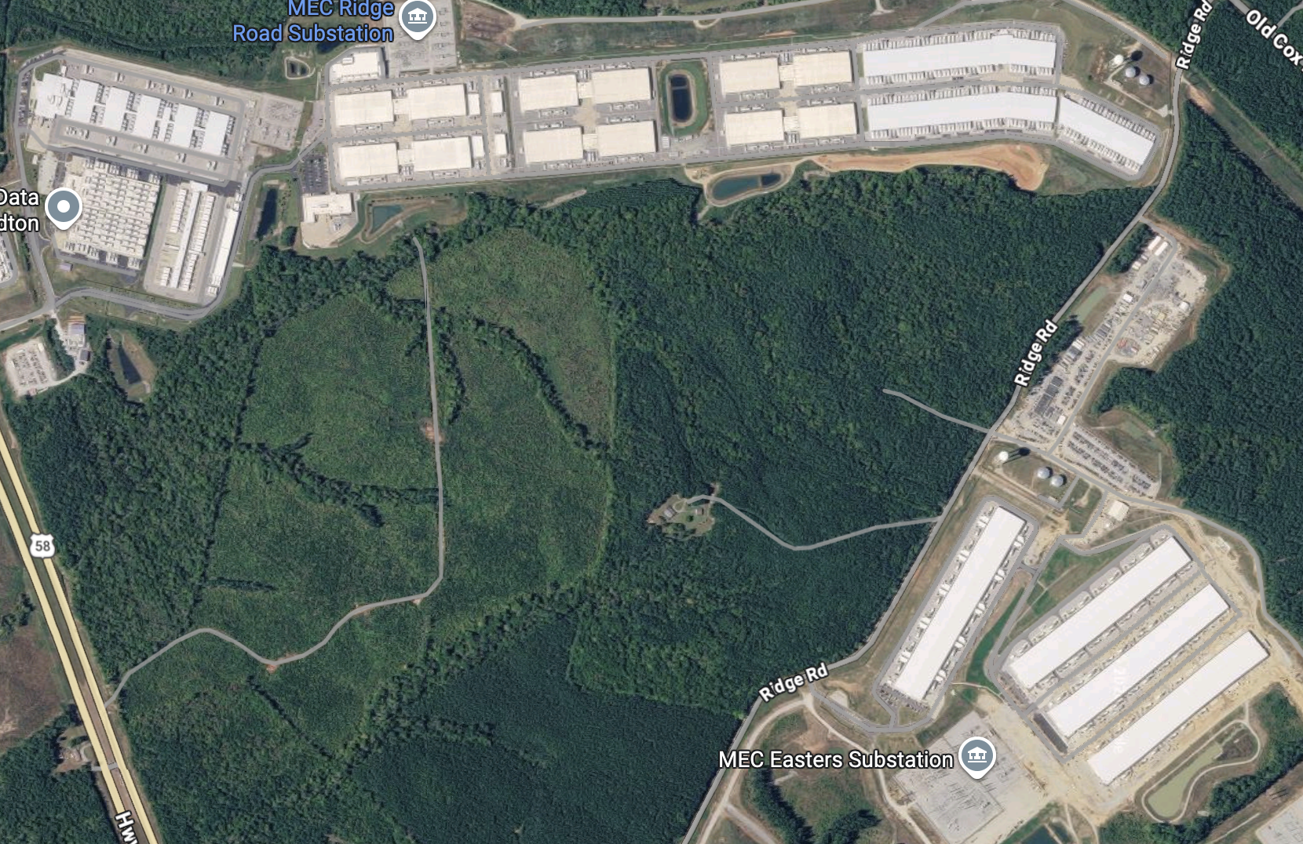

Slide 13

5.65 mile perimeter

Slide 14
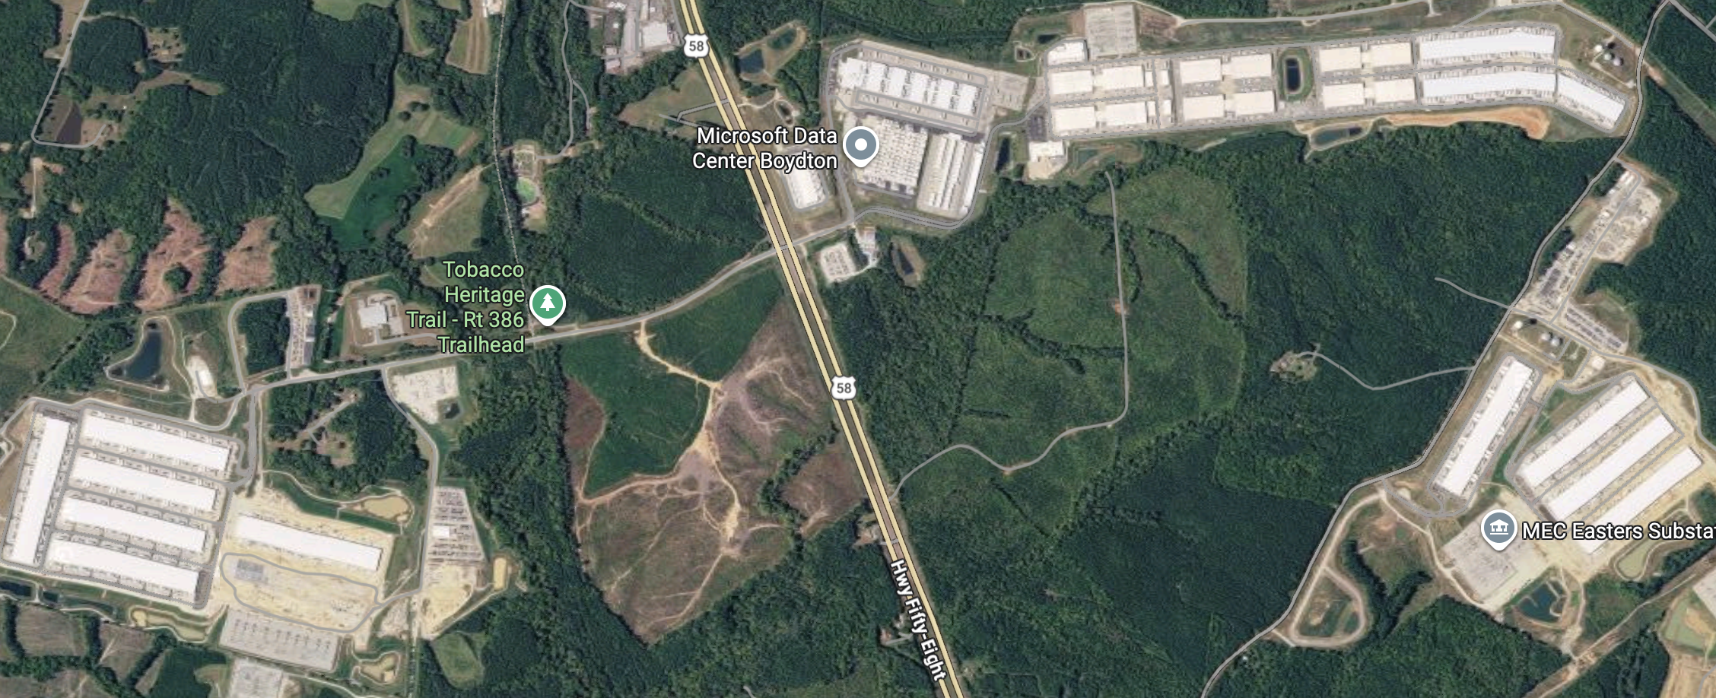
East US
East US 2

Slide 15
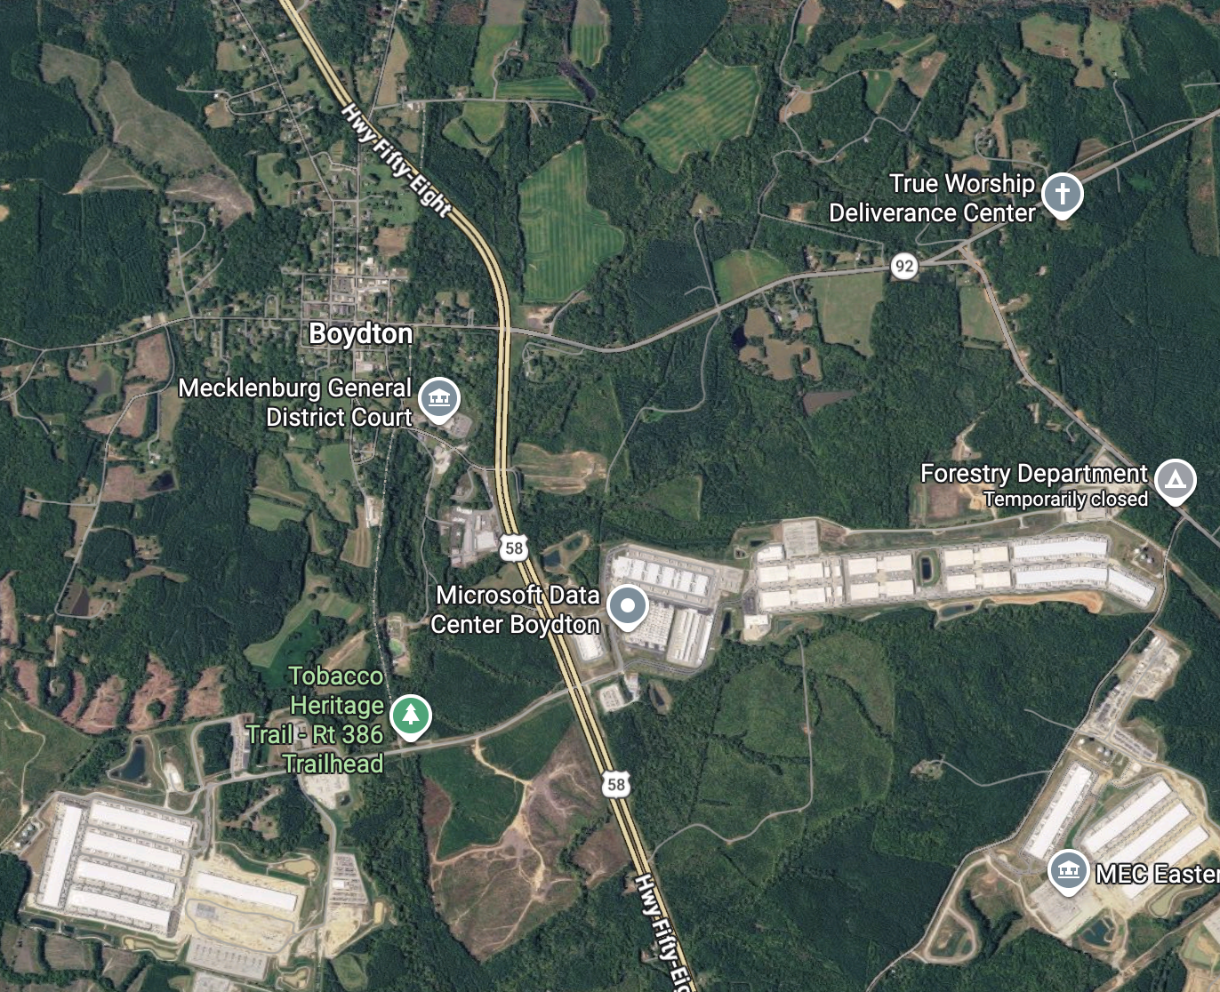

Slide 16
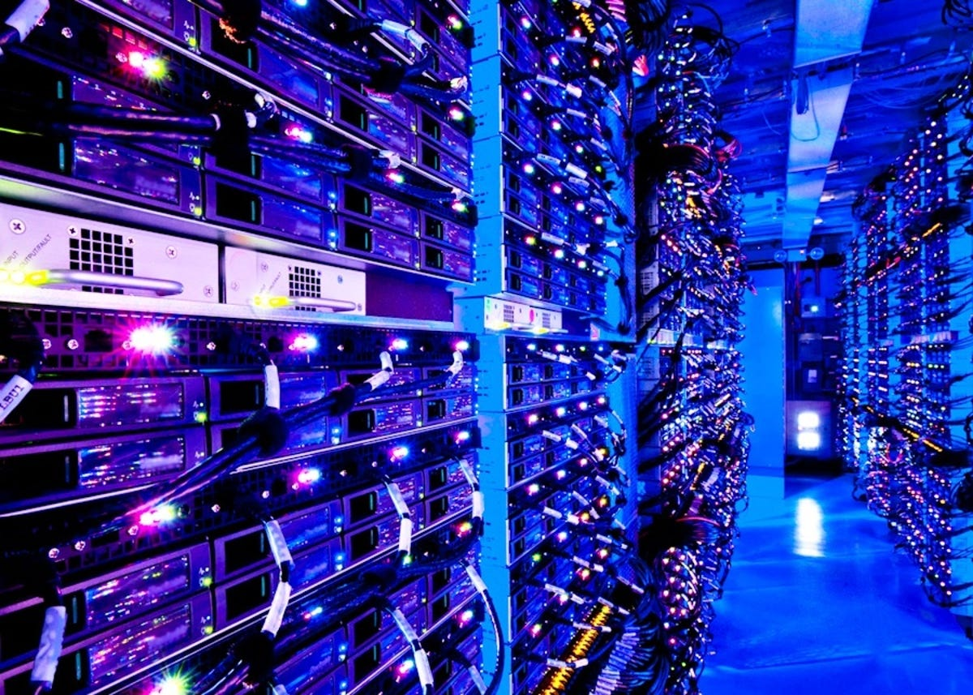
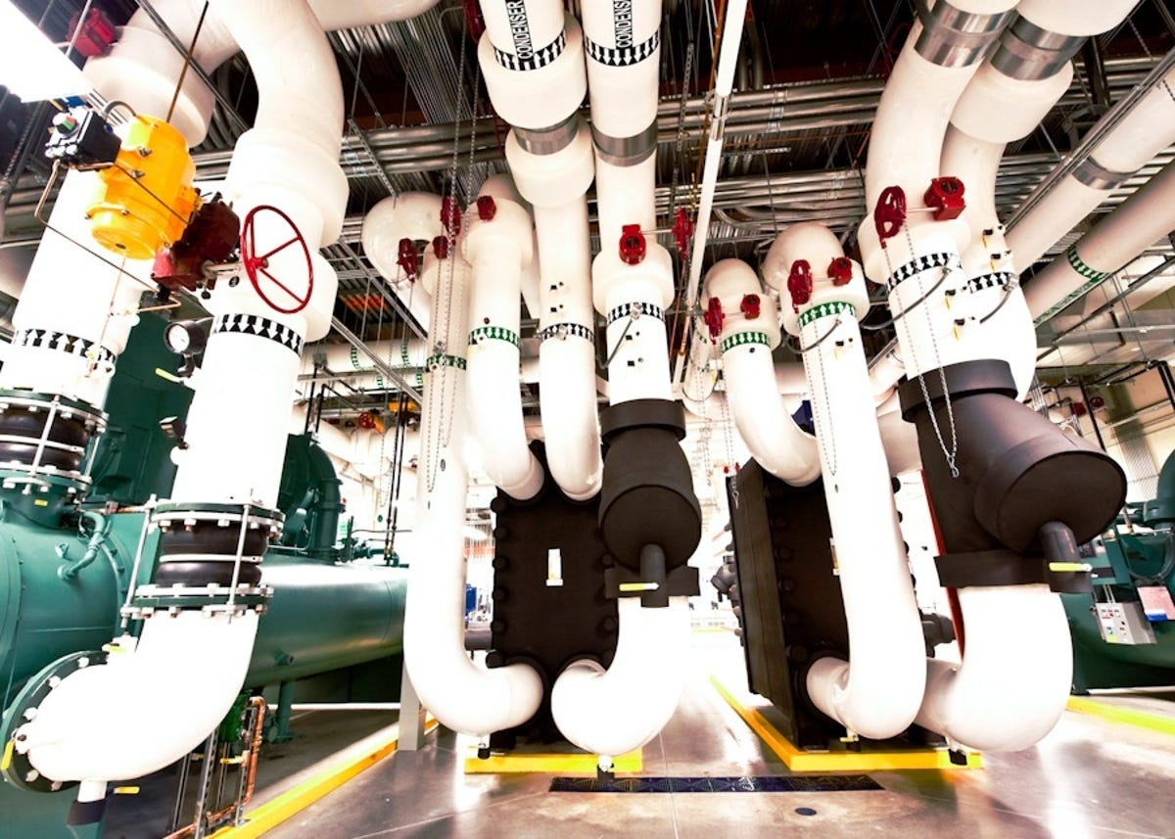
What's inside?

Slide 17
Why all these computers?
Scalability
Cost efficient
Ease of use
Moving fast

Slide 18
Cloud basics
Software building approach
Cloud equivalent
Build a server
Virtual Machine
Develop own messaging system
Teams, Slack, ...
Fully custom platform
Databricks, GitHub, ...
Building & maintaining
Renting
Notes:
Insert your text above

Slide 19
Cloud basics
Cloud equivalent
Terms
Infrastructure as a Service - IaaS
Virtual Machine
Software as a Service - SaaS
Teams, Slack, ...
Platform as a Service - PaaS
Databricks, GitHub, ...
Renting
Notes:
Insert your text above

Slide 20


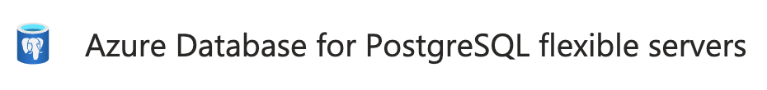


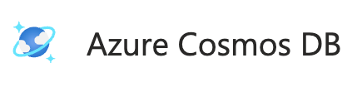
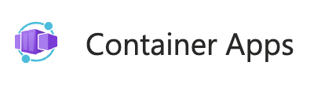








Azure terminology
Subscription
Resource group
Resources
And many more!

Slide 21




Resources for you
Container Apps
  Host an API/backend, auto scale down
Functions
  Host an API, only pay when used
  React to file uploads → also Azure Logic Apps
Static Web Apps
  Easily host a website
Host
Automate
Store – Entra ID
https://bovi-analytics.org/tutorials/databricks-naming-convention-compute.html
Notes:
Insert your text above

Slide 22
Cost management
Not always transparent
Don't blindly trust AI
Use budgets
Notes:
Insert your text above

Slide 23
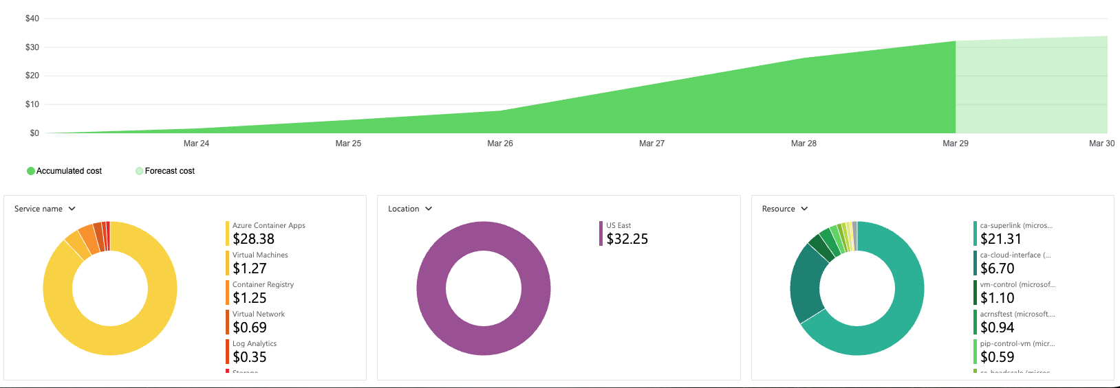
Cost management - case study
Initial: 4 VMs
AI revision: 1 VM, 3 ACAs
2nd revision: 2 VMs
$ 90 / mo
$ 180 / mo
$ 40 / mo
$30.59
$6.20
Notes:
Insert your text above

